Slide 1
30min-Ahead Gridded Solar Irradiance Forecasting using Satellite Data
Todd Taomae, Hawai`i State Archives
Lipyeow Lim, University of Hawai`i at Manoa
Duane Stevens, University of Hawai`i at Manoa
Dora Nakafuji, Hawaiian Electric Company

Slide 2
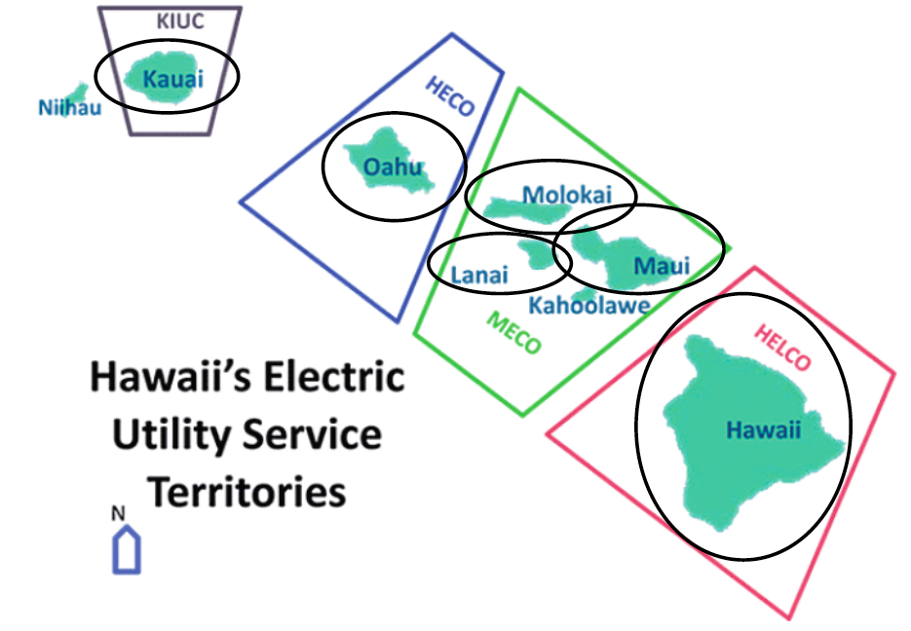

Background
85% of Hawaii’s electricity is from non-renewable sources (oil & coal).
Hawaii’s electricity cost 3x the US average
Goal: 100% renewable energy by 2045

Slide 3


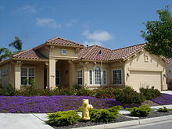


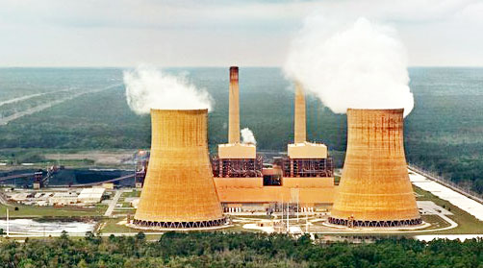
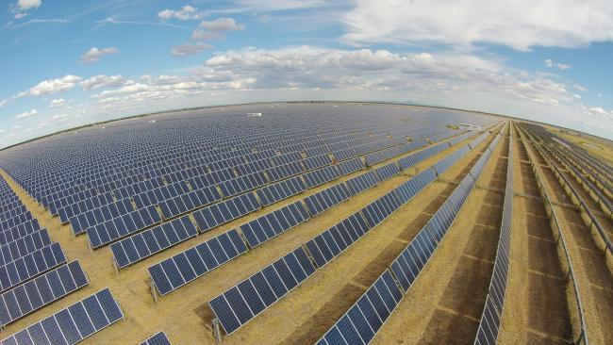
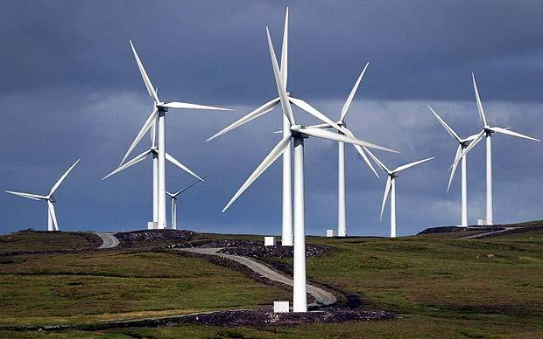
The Problem with Renewables (Solar)
Power Grid

Slide 4
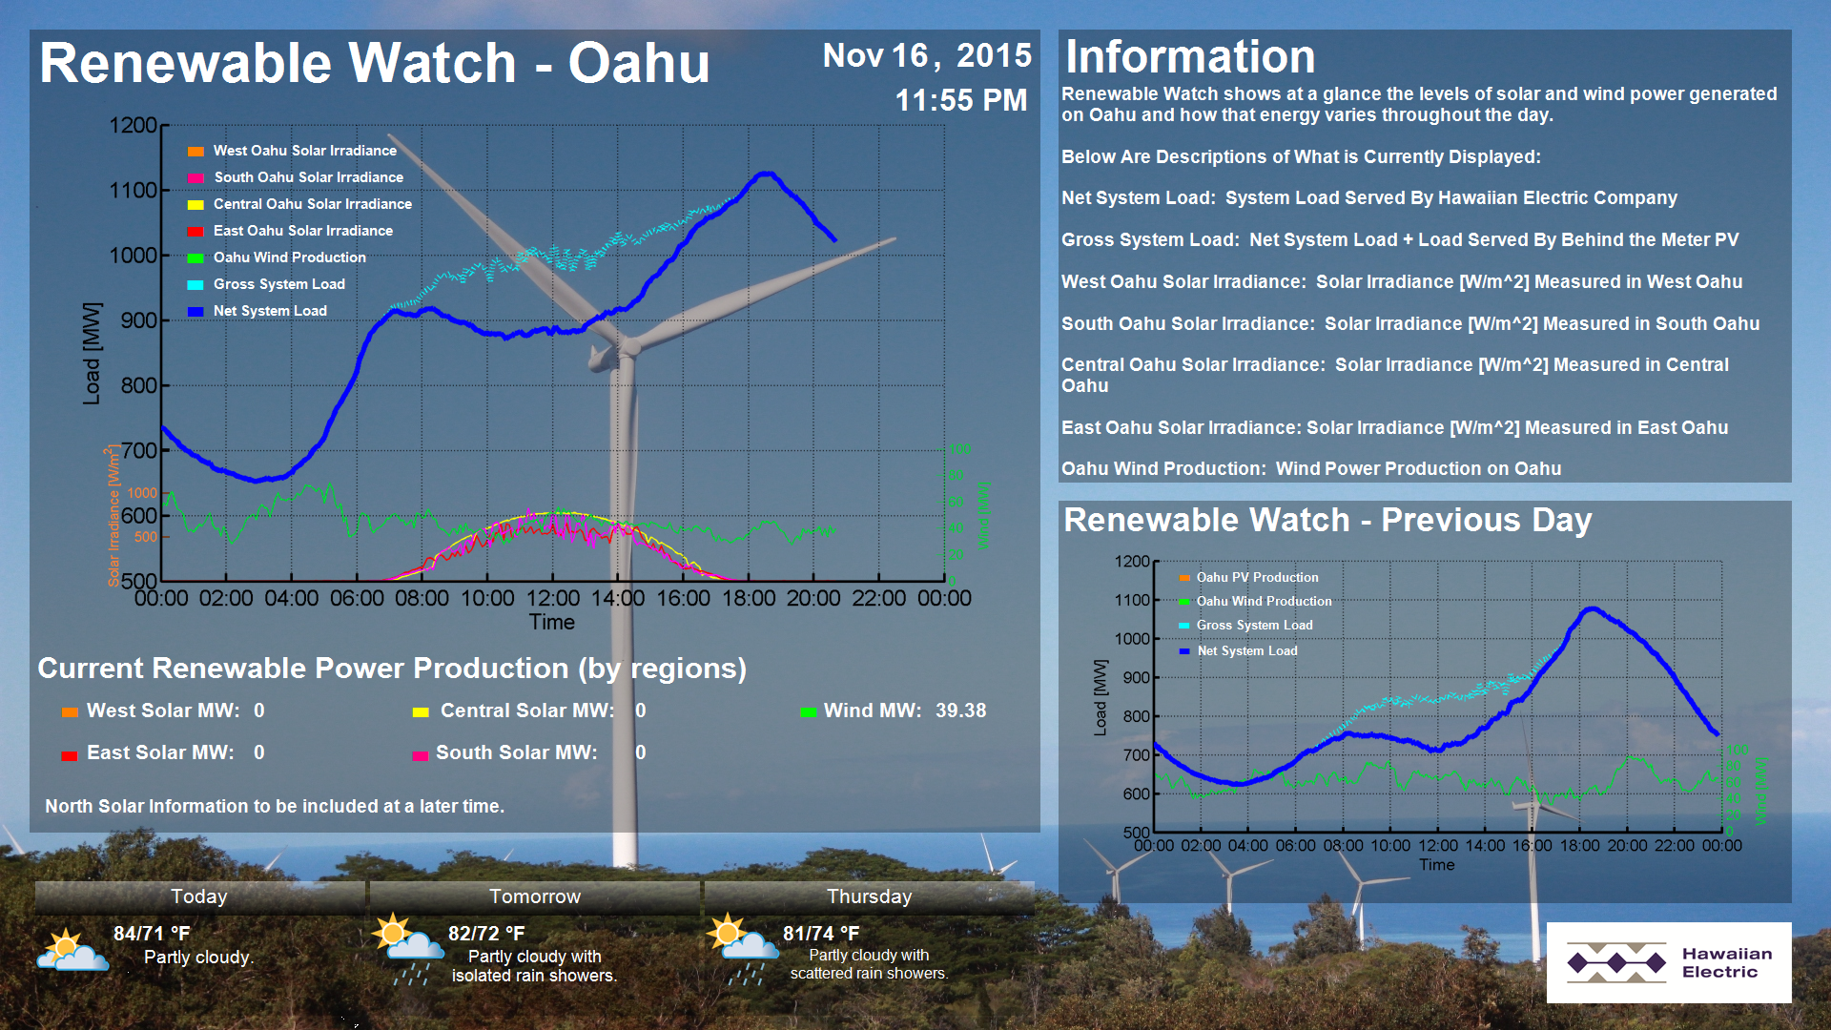
http://www.hawaiianelectric.com/heco/Clean-Energy/Integration-Tools-and-Resources/Renewable-Watch

Slide 5
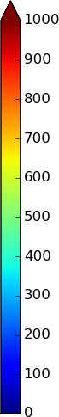
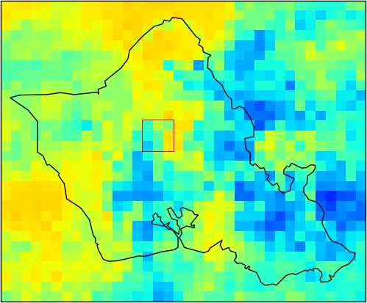
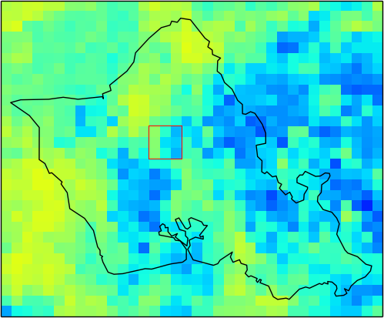
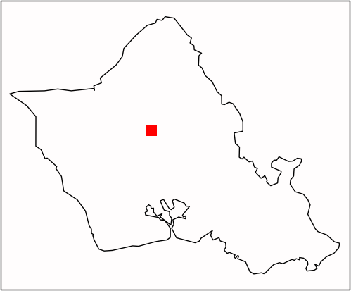
The Computational Problem
Not point forecast!
Gridded GHI data estimated from satellite images.
t-60
t-30
t
?

Slide 6
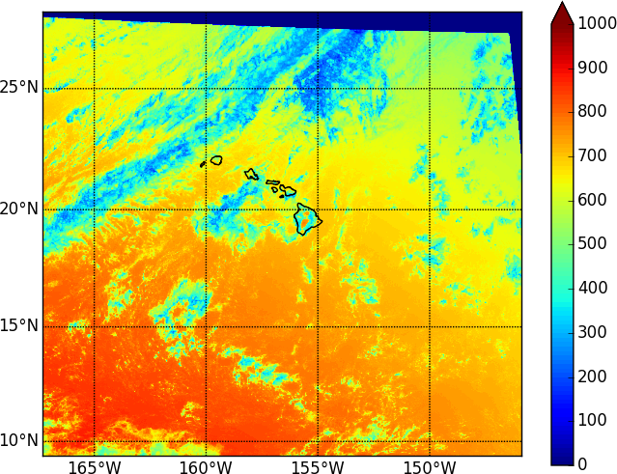
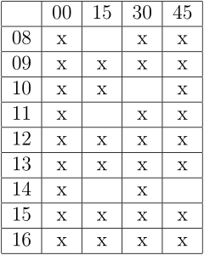
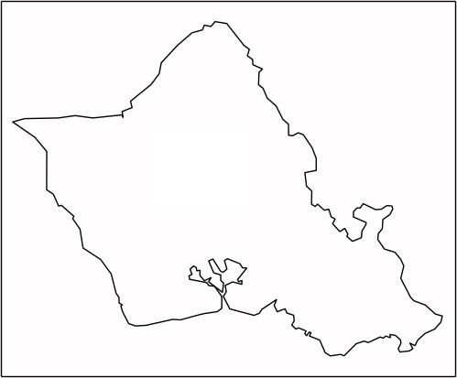
Data Set
2 years (2013, 2014) of global horizontal irradiance (GHI) data
Estimated from satellite images using “Perez method”
Measured in W/m²
~2 kilometer resolution
15 minute intervals
1120 x 1040 grid over Hawaii
36 x 29 grid over Oahu

Slide 7
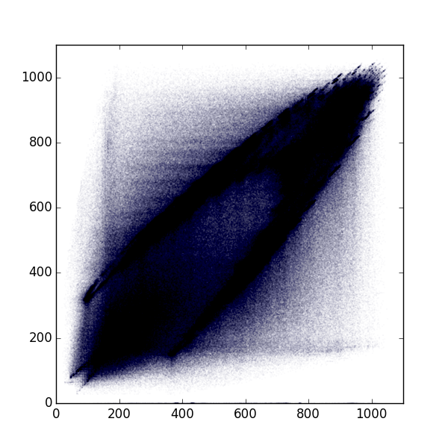

Linear Regression
Use linear regression model(s) to make short-term solar irradiance forecasts.
S(x, y, t) vs S(x, y, t-60)
For each grid point in Oahu grid
For each time between 8AM and 5PM

Slide 8
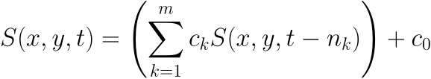
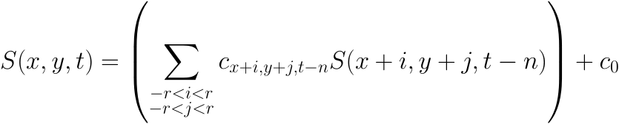
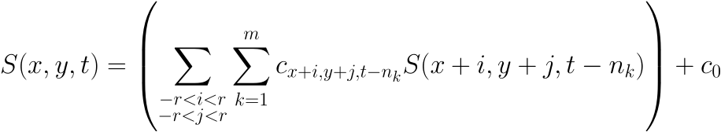
Adding Predictor Variables
We may be able to improve our predictions by including more predictor variables in our linear regression model.
Temporal - use additional past data
Spatial - use a small region surrounding the point of interest
Combine temporal and spatial

Slide 9
Adding Predictor Variables (Example)
Predict GHI at red square at time t using GHI from neighboring “pixels” at times t-30 and t-60.
t-60
t-30
t

Slide 10
Results
Average GHI at noon: 656.96 W/m²
Max GHI at noon: 1050.15 W/m²
Train on 2013, test on 2014
Single predictor variable model (30-minute forecast)
Mean Absolute Error (MAE): 109.16 W/m^2 (140.89)
Single predictor variable model (60-minute forecast)
Mean Absolute Error: 149.66 W/m^2 (178.17)

Slide 11
Results
Hour | MAE, [t-30] | MAE, [t-60]
8 | 56.60 | ---
9 | 89.11 | 118.81
10 | 116.68 | 151.25
11 | 133.92 | 174.51
12 | 125.93 | 160.05
13 | 111.58 | 139.00
14 | 92.95 | 112.78
15 | 98.19 | 130.56
16 | 112.31 | 190.36
Mean absolute error per hour
There are no predictions for 8 o’clock hour with [t-60] model
Since we only use data from 8AM to 5PM the earliest time we can predict is 9AM
(9:00 - 60 minutes = 8AM)

Slide 12
Results (Increasing Temporal Window)
Model (1x1) | MAE
[t-60] | 149.66 (178.17)
[t-60, t-90] | 150.33 (180.29)
[t-60, t-90, t-120] | 145.70 (177.52)
[t-60, t-75, t-90] | 149.05 (180.93)
[t-60, t-75, t-90, t-105, t-120] | 136.94 (172.04)

Slide 13
Results (Increasing Spatial Window)
Model | [t-30] | [t-60]
1x1 | 109.16 (140.89) | 149.66 (178.17)
3x3 | 103.15 (133.08) | 146.11 (173.45)
5x5 | 101.96 (131.35) | 145.38 (172.36)
7x7 | 101.39 (130.57) | 145.00 (171.82)
9x9 | 101.13 (130.20) | 144.82 (171.54)
11x11 | 101.01 (130.03) | 144.72 (171.40)
13x13 | 100.95 (129.93) | 144.67 (171.31)

Slide 14
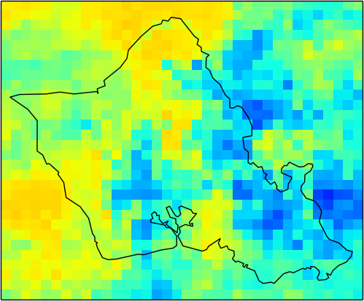
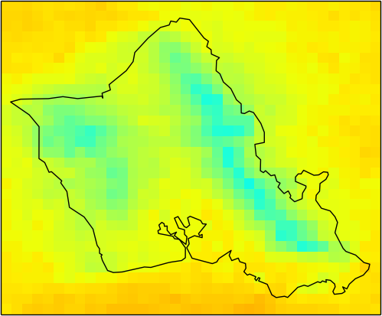
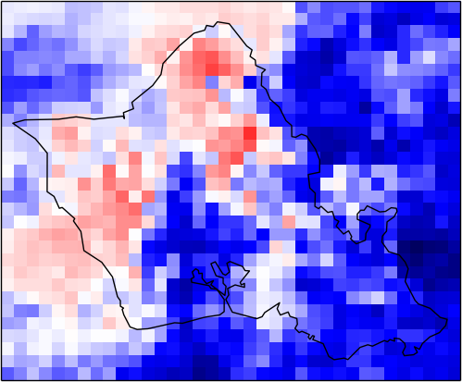
Data Transformation (Removing the Mean)
Partitioning the data reduces the amount of training data that we have for training each model.
Instead of partitioning we can try to transform the data to account for temporal and spatial patterns.
Create a model based on deviation from average per pixel, per time of day.
-
=

Slide 15

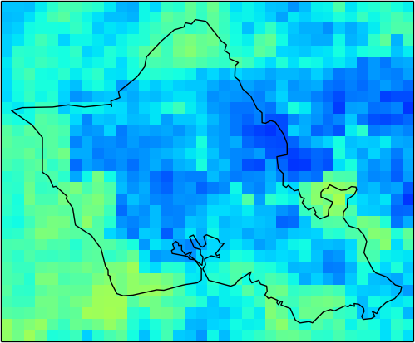
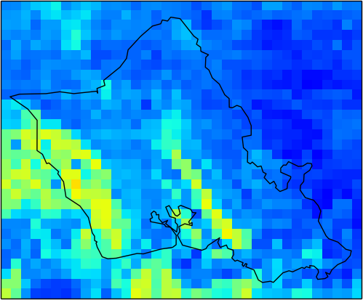
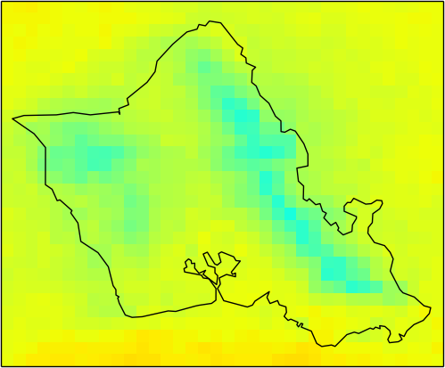
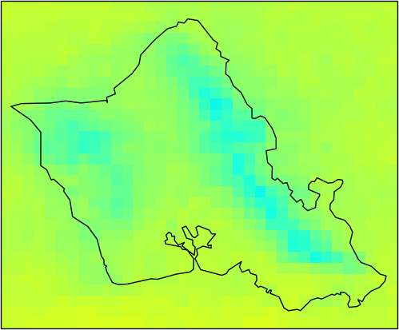
Calculating Average per Time
8:00am …
2:00pm
2:30pm
3:00pm
3:30pm …
Jan. 1, 2013
…
…
Jan. 2, 2013
⋱
⋮
⋮
⋱
⋮
Average
…
…

Slide 16
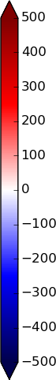
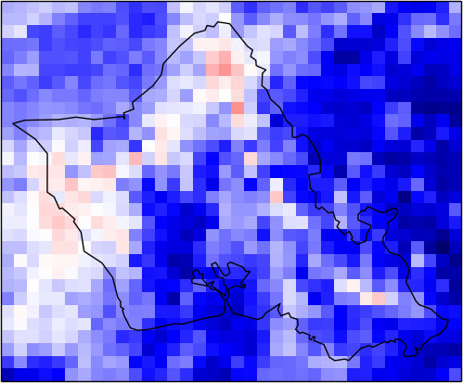
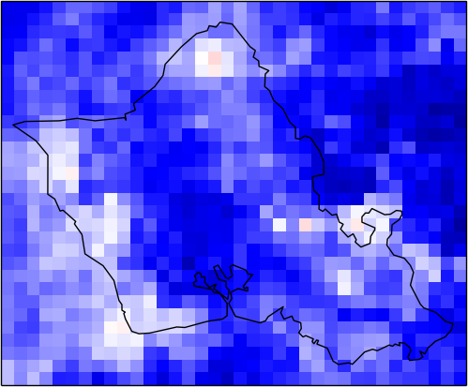
Calculating Difference from Average
-
-
-
=
=
=

Slide 17
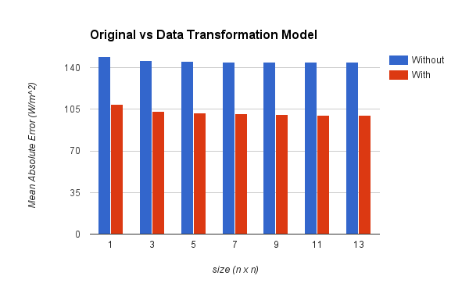
Results (Comparing Data Transformation Model)

Slide 18
Results (Increasing Temporal and Spatial Data)
 | 1x1 | 3x3 | 3x3 (With Data Transformation)
[t-60] | 149.66 (178.17) | 146.11 (173.45) | 103.55 (140.32)
[t-60, t-90] | 150.33 (180.29) | 141.27 (172.41) | 105.69 (142.49)
[t-60, t-90, t-120] | 145.70 (177.52) | 134.95 (167.95) | 108.82 (145.81)
[t-60, t-75, t-90] | 149.05 (180.93) | 140.50 (173.17) | 106.45 (143.93)
[t-60, t-75, t-90, t-105, t-120] | 136.94 (172.04) | 130.94 (166.13) | 114.53 (153.03)

Slide 19
Partitioning Data
We might expect different patterns for different times of day, different locations, etc.
For example, we expect GHI to generally increase throughout the morning and decrease throughout the afternoon.
Partition the data and create separate models for each partition
Morning vs afternoon
Seasons
Land vs ocean
High vs low elevation

Slide 20
Results (Temporal Partitioning)
1x1, [t-60]
 | Full Day | Morning | Afternoon
Full Year | 149.66 (178.17) | 109.65 (141.52) | 131.33 (163.59)
“Winter” | 144.38 (172.74) | 106.56 (138.74) | 127.13 (158.05)
“Summer” | 155.305 (183.12) | 112.64 (143.15) | 136.08 (169.39)

Slide 21
Results (Spatial Partitioning)
Model (1x1, [t-60]) | Grid Points | MAE
“Ocean” (elevation <= 0m) | 644 | 152.31 (180.76)
“Land” (elevation > 0m) | 400 | 144.37 (172.98)
0m < elevation <= 50m | 112 (28% of land) | 146.95 (174.96)
50m < elevation <= 100m | 43 (10.75% of land) | 146.19 (174.15)
100m < elevation <= 150m | 31 (7.75% of land) | 146.68 (175.56)
150m < elevation <= 200m | 23 (5.75% of land) | 147.53 (176.12)
elevation > 200m | 191 (47.75% of land) | 140.90 (170.34)
elevation > 500m | 37 (9.25 % of land) | 129.06 (159.73)

Slide 22
Conclusion
Linear regression based prediction for satellite-derived gridded solar irradiance data
Bunch of tricks:
Adding temporal data up to about 120 mins improves predictions
Adding spatial data continues to improve predictions up to 13x13, but the benefit is greatly decreased after 5x5.
Partitioning can help but we have less data to train each model.
Subtracting the mean image improves performance beyond any of the methods without the data transformation.
Adding temporal and spatial data can improve on top of the data transformation can improve predictions further.
Partitioning by geographical features didn’t help much – surprising.

Slide 23
Questions?

Slide 24
Results (Increasing Spatial Data with Data Transformation)
Model | [t-30] | [t-60]
1x1 | 89.83 (127.52) | 109.18 (146.64)
3x3 | 83.15 (119.87) | 103.55 (140.32)
5x5 | 81.65 (117.89) | 101.99 (138.34)
7x7 | 80.91 (116.89) | 101.07 (137.20)
9x9 | 80.53 (116.36) | 100.90 (136.48)
11x11 | 80.33 (116.06) | 100.08 (135.98)
13x13 | 80.21 (115.90) | 99.78 (135.64)

Slide 25
Mean Absolute Error given a particular GHI range
Actual GHI | Occurrences | MAE, [t-30] | MAE, [t-60]
0 < GHI <= 200 | 863,697 | 133.52 | 217.35
200 < GHI <= 400 | 2,041,311 | 108.81 | 154.83
400 < GHI <= 600 | 2,097,919 | 98.07 | 115.13
600 < GHI <= 800 | 2,054,205 | 100.01 | 129.40
800 < GHI <= 1000 | 1,336,697 | 120.38 | 179.40
GHI > 1000 | 4,842 | 145.43 | 235.49

